Slide 1
STTA - Study of the impact of closing six international/regional airports in Mozambique (part 1)
Facilitando o Ambiente de Negócios para o Crescimento Económico ( SPEED+)

Slide 2
Current Mozambique Aviation Policy
Mozambique has a liberalized aviation policy and more competitive approach
In line with a general trend of economic liberalization within the region (e.g. the Solemn Commitment for the implementation of the Yamoussoukro Decision). Implies greater market access to cross-border flights)
International entry points were defined as Maputo, Beira, Nampula, Inhambane, Vilanculos, Pemba, Tete, Nacala, and Linchinga.
Match reality of stretched-out geographic territory of Mozambique and need for direct connectivity to outlying entry points that are dependent on air links for economic development
SA Airlink and Kenya Airways operate direct services from neighboring countries to the remote Mozambique destinations affected by AdM's Proposal
However, no Mozambique airline has taken up such rights (excluding from Maputo, Beira and Nampula)
Dual designation of airlines is possible at these entry points

Slide 3
Impact of Mozambique Aviation Policy
Integrated aviation strategy encourages tourism and business development
This is successful:
  Substantial new hotels, operators and project investments (Some loan funding)
  Generates direct employment and economic growth
  Stimulate indirect employment and suppliers developed (catalytic effect)
Direct access from South Africa and Kenya is necessary for project workers, investors, traders and tourists
Back-to-back rotation of essential staff is required by major projects

Slide 4
AdM's Proposal
Proposal is to reduce the number of international airports from 9 to 3 (Maputo, Beira and Nacala) as ‘hubs’ which will connect passenger traffic to the affected airports (those closed for international scheduled traffic)
International charter operations would still be allowed to the affected airports with international security requirements (but most costs will remain)
Direct journey from a foreign origin (or destination) to one of the affected airports would be broken in two segments, an international (over border) component to a main ‘hub’ airport and a local (domestic) component

Slide 5
Proposed ‘Hub’ Airport Strategy
Proposed hub airport | Nacala airport (North) | Beira airport (Central) | Maputo airport (South)
Spoke airport | Nampula Pemba Linchinga | Tete, Quelimane Chimoio | Vilanculos Inhambane
Spoke airstrip | Mocímboa da Praia Angoche and Lumbo | Songo and Ulongué | Inhaca Bilene and Ponta de Ouro

Slide 6
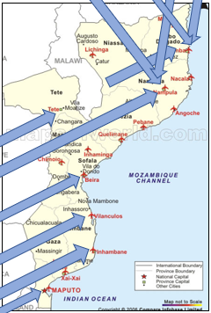
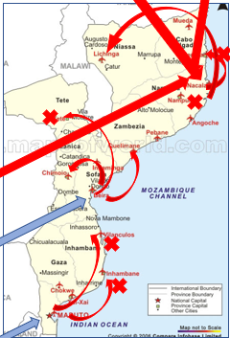
Graphical Illustration of Over-border Passenger Traffic Flow
Current Situation - Direct Over Border Access to Affected Airports
Proposed ‘Hub’ Model Over Border Access only via three ‘Hubs

Slide 7
Main Concerns of the Analysis and Proposal
Analysis mostly focused on the interests of suppliers (Nacala airport and LAM) and not the interests of demand (Passengers and other stakeholders, tourism, investors, business, economy, employment).
Represent a step back from the direction of economic liberalization and competition
Would reduce direct over-border connectivity, especially at outlying provinces of Mozambique contrary to multi-lateral attempts to increase cross borders flights in the region (e.g. the Declaration of Solemn Commitment towards the immediate implementation of the Yamoussoukro Decision).
Reduction in connectivity is contrary to ICAO recommendations (to increase connectivity) as current direct flights would now have to operate via additional and unnecessary transit points, trips would be longer, users will be exposed to additional risks of delay and prices will rise.
Such a reversal in policy direction would also obviate the economic benefits, employment and investment which was brought about by the opening of such airports
May assist LAM to monopolize the domestic market (competition risks)

Slide 8
Problems with the substance and details and of the AdM proposal (part 1)
AdM proposal incorrectly states that South Africa reduced number of international airports to 3, which is incorrect. South Africa currently has 10 international airports.
No quantum of cost savings were quantified AdM’s (would be negligible if any = remain open for non-scheduled international flights)
Analysis assumes an immediate large increase of 71% in LAM’s fleet by five regional aircraft - it currently has 7 aircraft) and 48% more seat capacity (= a new regional airline model) operating new unproven routes from a zero base of customer support
Assumption that demand will immediately rise to match the level of capacity increase, (actual overall pax traffic volumes are going down)
Contains no market research, historical substantiation or future assumptions that support its pax projections.
The proposed pax traffic numbers are highly speculative and simply unrealistic.

Slide 9
Problems with the substance and details and of the AdM proposal (part 2)
Demand takes time to develop, during which airlines incur huge start-up losses
LAM is not in a healthy financial position to assume such risks
Mismatch of projected routes and pax projections and the AdM proposed routes (e.g. flights to Tete and Quelimane, Chimoio and Nampula are planned to be operated from Maputo, and not from Beria as is contained in the AdM proposal)
Pax traffic in Mozambique is sparse (not dense), below critical mass for proposed rapid increase
For consumers, the proposal implies additional cost, longer journey time and loss of connectivity
Risk = existing volumes of passengers from neighbouring countries may reduce substantially with severe negative consequences to more outlying communities and economies

Slide 10
What are Airline Hub Operations
Cost drivers at airline hub
  Administrative head office
  Aircraft base
  Spares & components warehouse
  Maintenance base
  Crew location
Revenue drivers for Hub & Spoke route network
  Large local traffic base (High density O&D pax traffic, high frequency of flights)
  Central location necessary for hub
  A single airline seeks dominance at the hub
  Newer desirable LCC operations operate point-to-point services
    Higher average daily use of aircraft
    Match capacity to demand per route or groups of routes
    LCCs grow markets and are more profitable than FSNCs

Slide 11
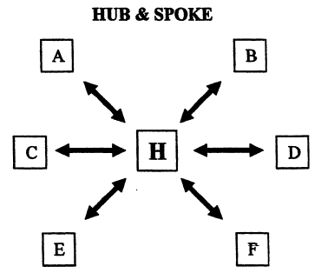
Airline Hub and Spoke Route Systems
Hubs are located where there are high volume of O&D pax traffic
Needs minimum critical mass of flights & pax
High volume of flights
Flights arrive and later depart in banks (groups) of 10-20 aircraft
Pax switch flights at hub airport
Hub airport geographically located in middle of route
network
Distance from spokes to hub needs to be similar
Enables less (fewest number) aircraft to be used
Highly susceptible to delays and cancellations

Slide 12
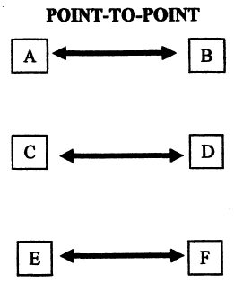
Airline Point-to-Point Route Systems
Passengers prefer direct flights (quicker & less cost)
Shortest elapsed flight time
Reduce travel time for pax & simplify air fares
Match seat capacity to demand per route
Higher daily aircraft and gate use than hubs
Applied by all Low Cost Airlines (LCCs)
Airport personnel can be utilized fully throughout the day
Flight crew utilization increase
Connectivity via a non-stop flight and elimination of the intermediate stop at the connecting airport provides savings of more than 30%
Avoid circuitous routings and increase aircraft block speeds

Slide 13
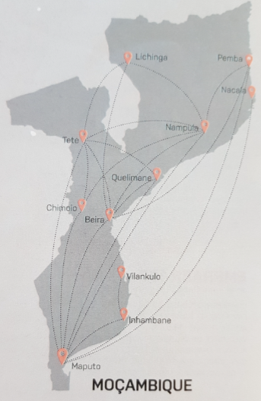
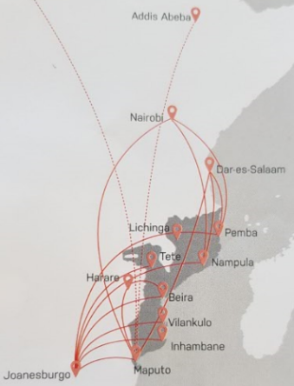
LAM’s Route System

Slide 14
LAM’s Route System
Mozambique’s territory is geographically stretched out
Overall traffic demand is sparse too little to attain economies of network density
LAM is trying to do too much with little number of aircraft
LAM’s performance (as a monopoly) to date is widely criticized
LAM’s operational base in Maputo, & Central and North is far & interconnectivity is underserved
LAM operates too few flights, with too little number of aircraft of too large capacity (compared to demand)
Low flight frequencies and rotations cause delay & cancellations & carry-overs
Extremely high level of transit pax (statistics) but associated with infrequent flights and low connectivity
Operation of more smaller aircraft directly (instead of via intermediate landings) would be more profitable

Slide 15
Air transport economics perspective
Hub & Spoke route network = a FSNC airline business practice, not an airport or regulatory practice.
Airlines are normally free to operate the routes chosen in any way. Not forced – regulated to operate commercially
Point-to-point route network = LCC airline business practice, which is increasing
Airports normally focus on increasing connectivity (invite more airlines to use the airport)
ICAO recommends that routes should have the minimum of transit points which:
  makes the trip as short as possible
  with optimal user satisfaction
  ​​​at the minimum price possible
  Airport connectivity includes both international and domestic destinations

Slide 16
Air transport economics perspective
​Proposal would reduce connectivity:
Increase distance of travel
Introduce intermediate stops, increase journey time, exposure to risks, delays
Increase price (international & domestic sector)
Reduction of regional connectivity (= reversal of liberalization steps & policy on over border access)
Proposal would reduce pax traffic drastically at affected airports (Pemba, Nampula, Tete, Vilanculos), harm communities & damage property and business investments
Regulations should not prescribe to airlines how to commercially operate their routes and businesses (If LAM wants to start new operations it needs no regulatory intervention)
Proposal would assist LAM to start a new regional airline with access to the passenger traffic on regional routes generated by Airlink and Kenya Airways

Slide 17
Concept of catchment areas
The concept of catchment is used to define the area within which most of the existing or potential traffic of an airport (as a destination or point of origin) lies.
A catchment area is defined as the area or sphere of influence of an airport or the portion of the market where a given airport dominates over other airports.
For business passengers 100km or 1-hour surface driving time (the so called 100km/1-hour-rule) = airport's typical minimum catchment area.
Some leisure passengers (who value time least) regard two hours of traveling time as appropriate as they may be prepared to travel further to an airport
The road between Nacala and Nampula represent about 2.5 hours travel (is risky, dangerous, passes through settlements and towns, have police roadblocks, slow moving traffic, pedestrians, animals and commercial activities)

Slide 18
Concept of catchment areas
Surface travel between Nacala and Pemba represent more than 6 hours 25 minutes of travel (384 km)
Nacala, Nampula and Pemba represent different catchment areas and markets
Therefore, most of traffic to Nampula and Pemba would not be diverted via Nacala and such traffic represent different markets
Research has demonstrated that less than 20% of pre-closure capacity is regained three years after closure for single carrier routes. On multi-carrier routes, only about 40% of pre-closure capacity is regained three years on.
Closure of international flights to Pemba and Nampula would cause long lasting damage

Slide 19
Pax traffic throughput at all affected (‘spoke’) airports
Pax Traffic Throughput at Affected Airports
VILANCULOS
INHAMBANE
TETE
NAMPULA
PEMBA

Slide 20
Origin and destination (Pax traffic flow) - Pemba
Notes:
LAM declining
Airlink 2016 increased

Slide 21
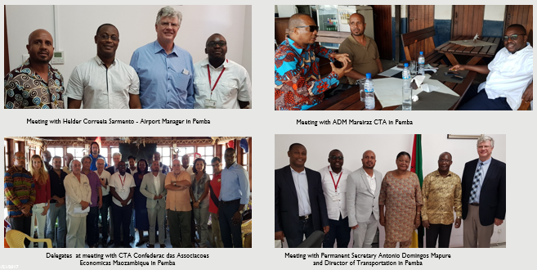
Discussions at Pemba

Slide 22
Pemba - Destination Attributes (Part 1)
Pemba operates as a central logistics hub for the mines and oil and gas operations (mainly North and North East)
Pemba is seat of the Provincial Government. Provides international exposure to Cabo Delgado and direct connectivity to neighbouring areas
Direct access to Pemba airport is important for development of Pemba & Province of Cabo. (Historic ties with neighbouring SADC countries - Tanzania, Kenya and now, South Africa)
Provincial integrated development program being drawn up – expect approval and investors conference in 2018
International scheduled flights connect Pemba to Dar es Salaam and to Johannesburg

Slide 23
Pemba - Destination Attributes (Part 2)
Direct connectivity required for:
  Rotation of technicians and workers on a back-to-back basis
  Workers are assembled in Johannesburg from various places in the world, then flown to Pemba in small groups. Reliability of flights are essential for scheduling
  Tourists require flights straight into the final destination of Pemba and not via an intermediate airport

Slide 24
Pemba - Destination Attributes (part 2)
  Pax = 70% for business purposes (Oil, Gas, Graphite, Ruby mining, Commercial, Fishing, Corporate staff, Government officials) & 30% for tourism (Airlink estimate it at 15%)
  Travel insurance do not cover LAM flights
  Tourism development = constrained as result of high ticket prices (fares)
  Experience in support services for Oil and Gas industries and mining is already established in Pemba, yet not developed in Nacala
  Medical evacuation directly to large hospitals in Johannesburg is required
  Door to door cargo shipments require direct access on scheduled flights and reliability and certainty of deliveries
  Pemba economy is down due completion of the initial stages of major oil & gas & other projects (departure of associated staff) and also influenced by lower oil prices
  Most new developments been put on hold

Slide 25
Pemba views on AdM's Proposal Page 1
The private sector, hotel industry, tourism, operators as well as Provincial Government are against AdM's Proposal and losing direct international access for Pemba
The looming decision creates uncertainty (inhibits) new investments and puts tourists off
Realities = There is no effective alternative links from Nacala to Pemba
  The road connections are not good (almost non-existent)
  There are no connecting airlines that offer services from Nacala to Pemba

Slide 26
Pemba views on AdM's Proposal Page 2
Risks of interruption of continued production is too great for the oil and gas industry
Estimated cost of delay of technicians are about $1million to $2million per day
Pemba and the region will fall back into oblivion
Hotels and tourist operators were encouraged to invest in Pemba and obtained loan funding – occupancy will fall severely, from current low base
The AdM proposal would be devastating on Pemba and Cabo Delgado
More destinations should be opened from Pemba
If the Airports Company is not interested in Pemba airport, a consortium would be prepared to purchase the airport

Slide 27
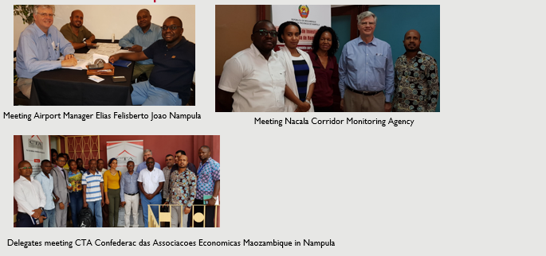
Discussions at Nampula

Slide 28
Origin and destination (Pax traffic flow) Nampula
Notes
All airlines declining
LAM down 49%
Airlink down 16%

Slide 29
Nampula - Destination Attributes
Nampula is the seat of Provincial Government, steady traffic demand for civil servants will remain for Nampula, unless the seat of Government is moved to Nacala
Passengers are traders, business people, Government officials, NGOs (UN refugee camp for displaced persons), and very few tourists.
10 minutes for traders connect to Nampula airport by Taxi at little cost (Much more to Nacala)
Nampula is already the hub for the north of Nampula province and traditional association of population (diaspora) in the region and neighbouring countries
Nampula is the destination of choice for pax. It represents a distinct different market for connectivity to other destinations than from Nacala
There is not enough demand at Nacala and only 2 domestic flights per week for Nacala. Substantial demand for Nampula connecting flights (domestic and international) and little real demand for Nacala airport
LAM reduced its flight frequency to two per week and the passenger train between Nampula and Nacala was terminated. This demonstrates insufficient demand for Nacala.

Slide 30
Nampula - views on AdM's Proposal Page 1
The AdM proposal would be negative for Nampula’s economy
Most persons, especially the private sector and development agencies were against AdM's Proposal
Companies and Government based in Nampula will not move, it would only increase cost and make connections more difficult, which will hamper the local economy
Flights from Nairobi, Johannesburg, Dar es Salaam (via Pemba) would divert some traffic but at a higher cost and time delay
As most international traffic relates to Nampula, a move to Nacala airport would increase traffic on connecting road.

Slide 31
Nampula - views on AdM's Proposal Page 2
The Nampula – Nacala road attracted many people who live along the road and use it for selling, commuting, travelling and trading. It is dangerous and prone to accidents and breakdowns with many stops and delays. This pose a risk of missing flights or complicate matters if there are flight delays.
Despite all the lower cost advantages and incentives of Nacala, air fares are substantially higher to Nacala than to Nampula, when the cost of road transport to Nampula has to factored in.
Nacala need further infrastructure, hospitals, hotels have not been developed as originally planned
One isolated view suggested that although it may be negative to the local economy, it can perhaps benefit the country as a whole

Slide 32
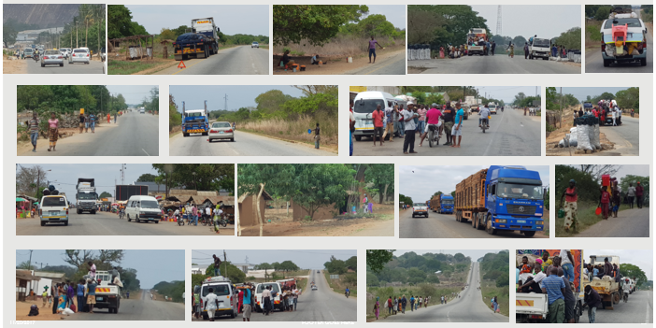
Road between Nampula and Nacala

Slide 33
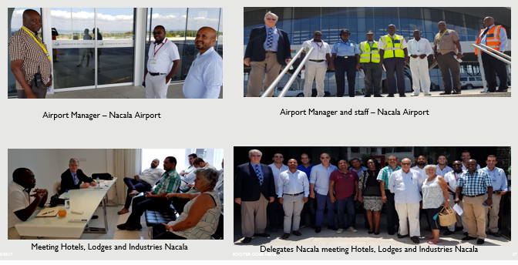
Discussions at Nacala

Slide 34
Nacala - Destination Attributes Part 1
Excellent facilities for pax and cargo exist at airport. They are well maintained, clean and maned by friendly airport staff. Some of the departure / arrivals halls can be used for conferences and functions to stimulate demand
The original overall development plan for the transport integrated hub of sea, rail and air connections has not been completed
Nacala is an industrial city with the image of a coal terminal
LAM’s operations killed the business. Tickets are about $100 more expensive than flights to Nampula despite lower costs, its operations are not reliable, delays
Less demand for LAM’s flights from Nacala than from Nampula.

Slide 35
Nacala - Destination Attributes Part 2
Business traffic (Nacala and Tete) possible re coal mining operations of Vale. However, Vale does not support this. Vale operates own aircraft based in Nacala.
Critical to have large enough scale of domestic flights to improve Nacala’s connectivity with other domestic airports (LAM only connects with Maputo)
Nacala airport did not publish instrument approach procedure and therefore Airlink cannot operate services JNB-MNC
There is no effective alternative link from Nacala to Pemba or Nampula
  No effective road connections
  No connecting airlines that offer services

Slide 36
Nacala - views on AdM's Proposal
Further investments required to make the airport fully functional for airlines. Includes hospitals and hotel investments and publication of instrument approach procedure
Nacala should start afresh, launch a tourism development mechanism similar to the Wesgro developments in South Africa.
Nacala should attract a small airline to commence services from Nacala as its base of operations to develop connectivity
Nacala needs more connectivity to domestic destinations to link to international routes
If international flights are operated rom Nacala then about 50% of Nampula’s passenger traffic would use Nacala (This may be high taking the road condition into account)
It is to soon to use Nacala as a hub to replace international connections to Pemba, Nampula and Tete

Slide 37
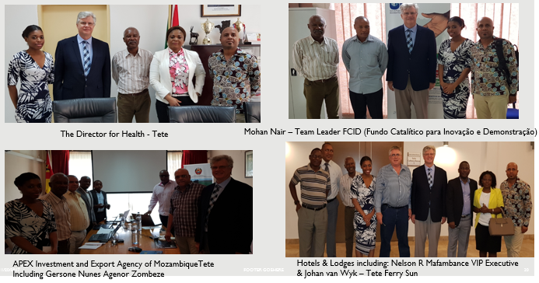
Discussions at Tete

Slide 38
Origin and destination (Pax traffic flow) Tete
Notes:
LAM increased market share
Both Airlink and LAM pax
volumes reduced 2015 to 2016
Airlink steady decline since
2012
STTA - Study of the impact of closing six international/regional airports in Mozambique

Slide 39
Tete - Destination Attributes Part 2
Major projects facilitated by the Agency Zambezi include Iron and Steel as well as mining and processing of steel; poultry industry; hotels; hydro energy and other businesses to develop growth.
Lots of investment partnerships are dependant on direct connections, which also brings people into Tete to projects that create employment. Many foreigners are essential for mining and other projects.
International access to regular flights to Johannesburg are crucial for the development of the province.
The traffic volumes to Tete will reduce substantially if flight routings have to be made via Beira. There are financial implications if people cannot expect to be on time for meetings.
New project financing depends on people that are flown in from Johannesburg. There are a number of projects which are almost at their commissioning and operational phase.

Slide 40
Tete - Views on AdM's Proposal Page 1
Largest mine (Vale), private sector, hotel industry, as well as Provincial Government are against AdM's Proposal and losing direct international access for Tete
The closure would create a domino effect, as hotels’ employees would be reduced for cost savings and local suppliers are dependent on the continued hotel operations
The Local Provincial Authority is opposed to the closure of Tete of International scheduled:
  Flexibility - Passengers prefer to fly direct and non-stop to South Africa.
  The cost of ticket prices is lower than LAM and more reliable
  Pax demand will reduce substantially.
  Onward connection via a third destination will not be regarded as favourable
  Expats come to Tete due to mining activities, which is dependant on direct flights.
  From a health perspective, persons can in serious cases be flown directly to Johannesburg to receive proper medical care

Slide 41
Tete - Views on AdM's Proposal Page 2
The AdM proposal will negatively impact Vale’s business as it has Service Providers and Specialist Technical expertise coming to Vale’s site from South Africa on a daily basis. Airfreight cargo also feed Vale’s logistics chain.
Direct Foreign Investment (DFI) require direct access to Tete operations offices and should be independent on Beira and Nacala, which are not in the Tete province
Staff requiring urgent medical attendance need to be evacuated directly to Johannesburg (faster from an international airport)
If LAM delays and flight cancellations happens at an intermediate landing airport (Beira) the delays would be exacerbated. There is no WiFi at airports to enable bookings for overnight accommodation in case of delays

Slide 42
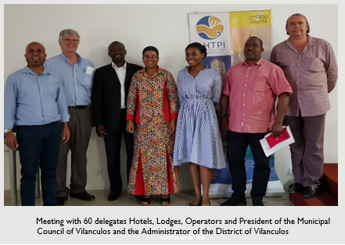
Discussions at Vilanculos

Slide 43
Origin and destination (Pax traffic flow) - Vilanculos
Notes:
High value tourism
Airlink significant growth
LAM in consistent decline
Airlink combine sea/marine
with Kruger Park (compete
with Seychelles and Mauritius)

Slide 44
Vilanculos – Destination Part 1
The massive development of Vilanculos was brought about through the development an international airport at Vilanculos and direct links to South Africa as a bridge for tourists to visit Vilanculos.
The development of tourism in Vilanculos is in line with Government objectives.
Apart from Johannesburg Nelspruit provides connections for tourists to combine beach activities with the Kruger National Park.
Many successful hotels and lodges were developed and tourism’s economic impact has created jobs and economic development for the whole area caused indirect employment of more than 80 000 persons.
The tourism offers a better potential for local development than the oil and gas (petrol) activities.

Slide 45
Vilanculos – Destination Part 2
Further investments have already been hampered by the mere announcement of the potential closure of the airport for regular international traffic
Some of the islands have the most luxurious and expensive resorts and hotels that would also be affected.
The archipelago of Bazaruto is a world-famous landmark rated as the 6th tourism wonder of the world. It should not be eliminated by the closure of the airport as such.
Vilanculos is already competes with more expensive destination like the Seychelles islands and Mauritius, which are directly accessible. Most foreign visitors come to Vilanculos via South Africa.
LAM does not have enough aircraft available to offer the same connections that are currently operated. Many tourists cannot get medical insurance for LAM flights, which is necessary to travel to far off unknown destinations.

Slide 46
Vilanculos - views on AdM's Proposal
A very large continent of about 60 persons is totally against AdM's Proposal
The Government encouraged investment in Vilanculos and substantial investments have been made, employment created. This will all be lost if AdM's Proposal proceeds.
Closure of the airport for regular international flights will be a huge mistake that would impact investors and employment significantly and will negatively affect Vilanculos
About 400 tourists cancelled their bookings when AdM's Proposal was announced
The Solida hotel project has been cancelled on rumours that the Vilanculos airport may be closed
LAM does not have the capacity to offer direct international flights and cannot replace the Airlink flights.
The airport manager expressed a choice of two alternative scenarios:
  The development of national interest (aviation industry) national airlines (LAM)
  Negative impact on tourism and the local economy

Slide 47
Origin and destination (Pax traffic flow) - Inhambane
Notes:
LAM has monopoly
Airlink does not operate
LAM in consistent decline
More resorts than Vilanculos
Very low resort occupancy
Old airport & distance to
resorts

Slide 48
Recommendations: What should be done? Part 1
Maintain 9 entry points for over border flights & publish such decision
If XaiXai airport is built, add it to the entry points
Actively encourage more airlines (especially Mozambique airlines) to operate over-border services (increase level of competition in frequency of service and prices)
Possible examples:
  Connections of Mozambique to Kruger National Park (Nelspruit?)
  Connections to Swaziland Airport & Livingstone (Zambia)
  Direct links to Cape Town and Durban (in addition to Johannesburg)
STTA - Study of the impact of closing six international/regional airports in Mozambique

Slide 49
Recommendations: What should be done? Part 2
Make Nacala navigable and encourage small airlines to start operations at Nacala
Support smaller airlines for essential links (like EU and USA programmes)
Concession smaller airports where possible, which will require recertification with greater rights if upgraded
Leave the route scheduling decisions to the airlines, do not regulate how airlines should operate commercially
Encourage development of essential routes and tourism and business economic zones through tax incentives to match development objectives

Slide 50
Back-up Slides

Slide 51
LAM - Aircraft and Seat Capacity expansion

Slide 52
Airports Compared JNB CPT MPM
Airline and Destination Connectivity

Slide 53
International Airports in the Region
Details of International Airports in the Region

Slide 54
Proposed Routes to motivate AdM's Proposal

Slide 55
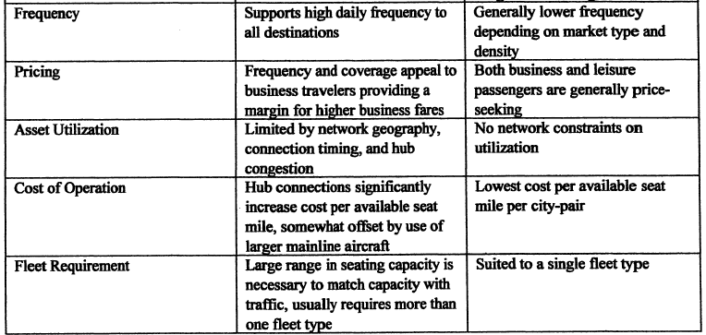
Comparison of the two airline route network systems Part 2
Source: Gerald N. Cook & Jeremy Goodwin, Airline Networks: A Comparison of Hub-and Spoke and Point-to-Point Systems, Journal of Aviation Aerospace Education & Research (JAAER),
Winter 2008, Volume 17, Number 2, Embry-Riddle Aeronautical University.

Slide 56
Thank you

